Slide 1

MEDICAL CONDITION CLASSIFICATION USING NLP
M D SRI RAAGHAV (103122060)
at
Computer Applications Department, NIT Trichy
M D SRI RAAGHAV (103122060) / B.Tech. / Civil Engg. / NIT-T

Slide 2
OBJECTIVES / INTERNSHIP GOALS
To develop an AI model capable of classifying medical conditions based on textual drug reviews.
To preprocess unstructured medical text data using NLP techniques.
To apply and compare classification algorithms such as Multinomial Naïve Bayes and Passive-Aggressive Classifier.
To evaluate model performance using metrics like accuracy, precision, recall, and F1-score and confusion matrix.
To explore the real-world application of NLP in healthcare analytics for improving diagnostic support.
2
M D SRI RAAGHAV (103122060) / B.Tech. / Civil Engg. / NIT-T
Notes:
2

Slide 3
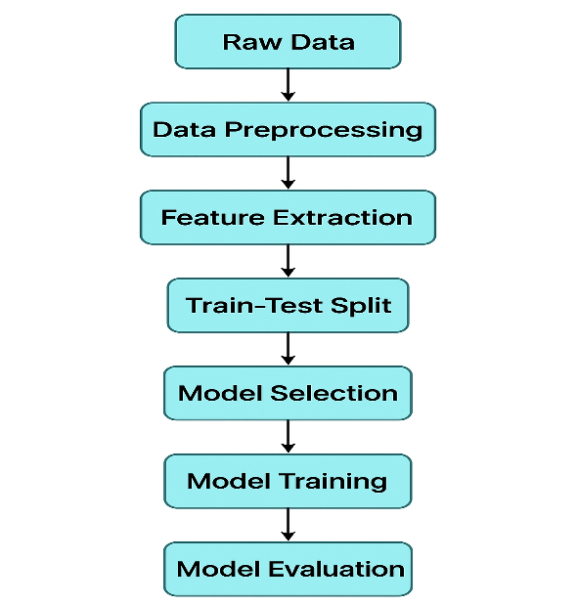
METHODOLOGY FLOW CHART
2
M D SRI RAAGHAV (103122060) / B.Tech. / Civil Engg. / NIT-T
Notes:
2

Slide 4
METHODOLOGY WORKFLOW
Workflow of the Medical Condition Classification System
Data Collection – UCI Drug Review Dataset (215,000+ entries)
Data Preprocessing – Stopword Removal, Lemmatization, Tokenization
Feature Extraction (Done before the split to prevent Data Leakage) – TF-IDF Vectorization
Model Training –
Multinomial Naïve Bayes
Passive-Aggressive Classifier
Model Evaluation – Accuracy, Confusion Matrix, F1-Score
Result Interpretation & Comparison
2
M D SRI RAAGHAV (103122060) / B.Tech. / Civil Engg. / NIT-T
Notes:
2

Slide 5
CONCEPTS / MECHANISM / THEORY
1. Natural Language Processing (NLP)
Definition:
Natural Language Processing (NLP) is a field of Artificial Intelligence that enables machines to understand, interpret, and generate human language.
Core Steps in NLP Pipeline:
Text Preprocessing:
Tokenization: Breaking sentences into words.
Stopword Removal: Removing common words (e.g., “the”, “is”).
Lemmatization: Reducing words to their base form (e.g., running → run).
Vectorization: Converting words to numerical form using TF-IDF or word embeddings.
Goal:
Convert raw text → structured numerical data → input for ML models.
2
M D SRI RAAGHAV (103122060) / B.Tech. / Civil Engg. / NIT-T
Notes:
2

Slide 6
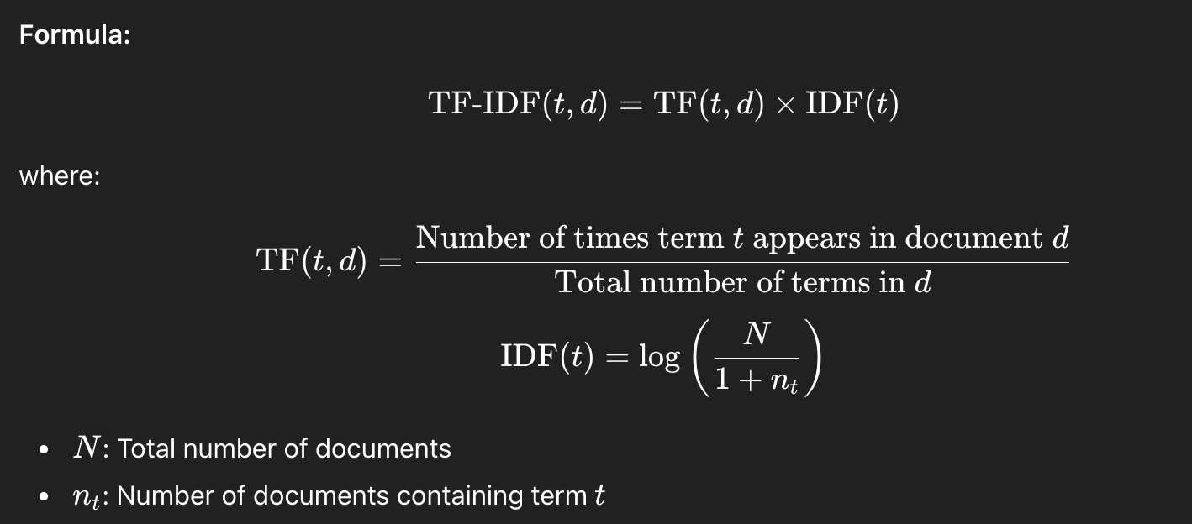
CONCEPTS / MECHANISM / THEORY
2. TF-IDF (Term Frequency – Inverse Document Frequency)
Purpose:
TF-IDF measures how important a word is within a document relative to the entire corpus (large collection of text). It reduces the weight of commonly used words and increases the weight of rare but informative words.
Intuition:
High TF-IDF → term appears frequently in one document but rarely elsewhere → important word.
Low TF-IDF → term appears in many documents → less informative.
2
M D SRI RAAGHAV (103122060) / B.Tech. / Civil Engg. / NIT-T
Notes:
2

Slide 7
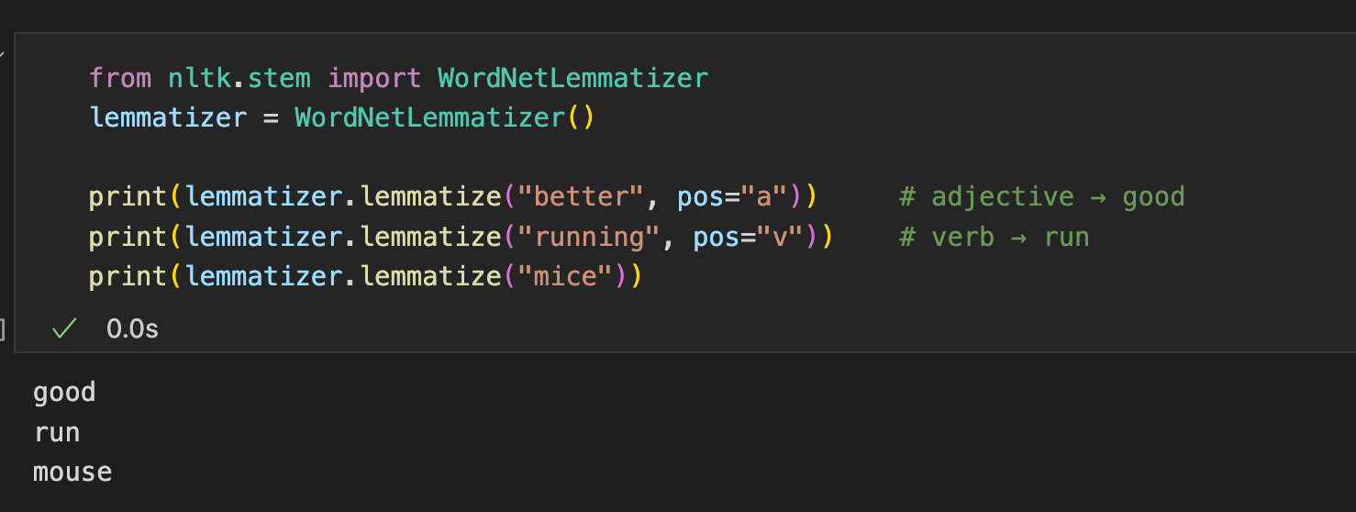
CONCEPTS / MECHANISM / THEORY
3. Lemmatization (in NLP)
Lemmatization is the process of reducing a word to its base or dictionary form, called a lemma.
It helps the model treat different forms of a word as the same word.
2
M D SRI RAAGHAV (103122060) / B.Tech. / Civil Engg. / NIT-T
Notes:
2

Slide 8
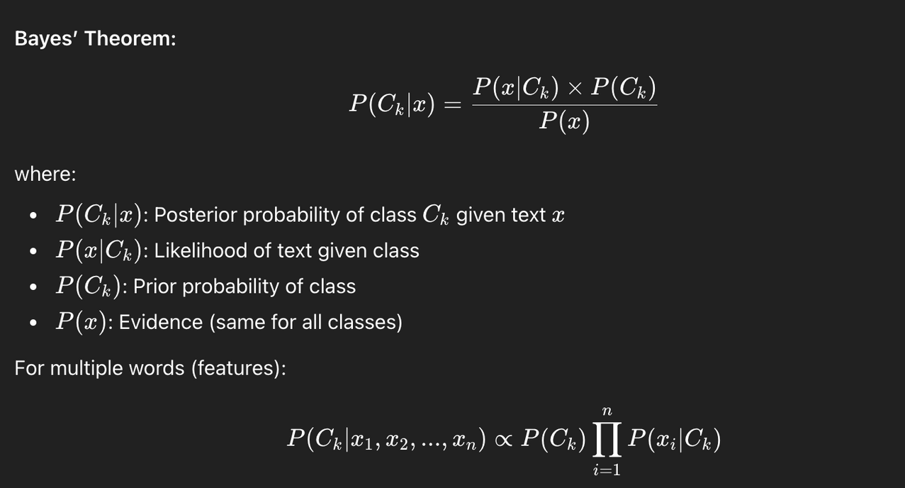
CONCEPTS / MECHANISM / THEORY
4. Multinomial Naïve Bayes Classifier
Concept:
A probabilistic classifier based on Bayes’ Theorem that assumes all features (words) are independent of each other.
Intuition:
Simple, fast, and effective for text classification.
Performs well when features (words) are conditionally independent.
2
M D SRI RAAGHAV (103122060) / B.Tech. / Civil Engg. / NIT-T
Notes:
2

Slide 9
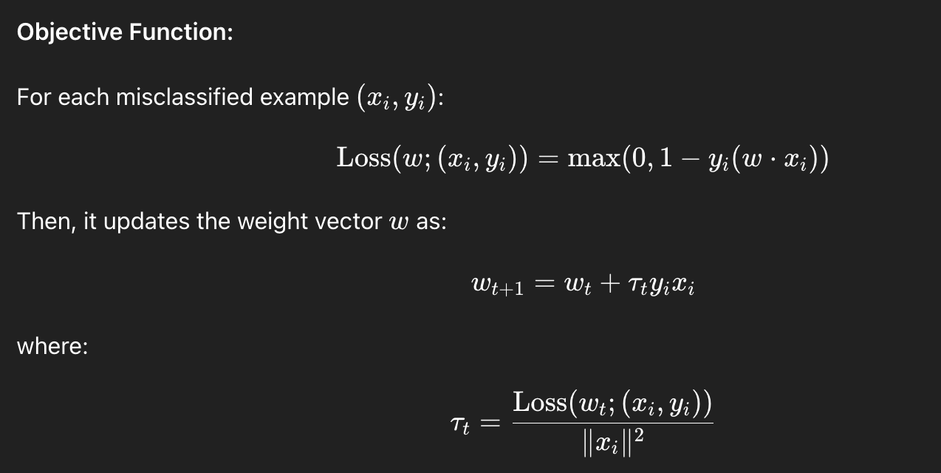
CONCEPTS / MECHANISM / THEORY
5. Passive-Aggressive Classifier
Concept:
An online learning algorithm that updates its model only when a misclassification occurs — hence the name Passive-Aggressive.
Key Properties:
Passive → no update if prediction is correct.
Aggressive → adjusts aggressively on misclassification.
Efficient for large-scale, real-time text streams.
2
M D SRI RAAGHAV (103122060) / B.Tech. / Civil Engg. / NIT-T
Notes:
2

Slide 10
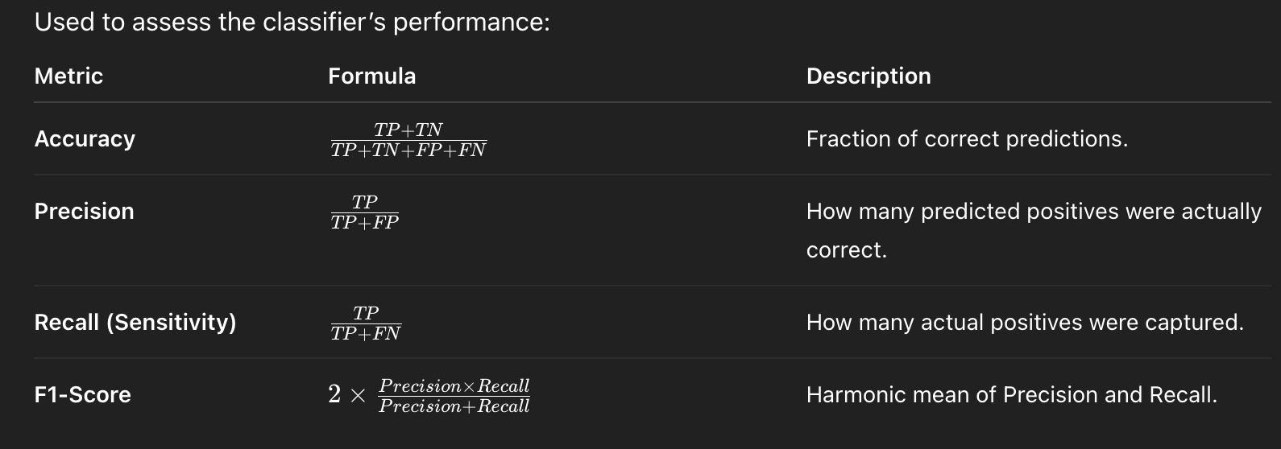
CONCEPTS / MECHANISM / THEORY
6. Evaluation MetricsConcept:
Where:
TP: True Positives
TN: True Negatives
FP: False Positives
FN: False Negatives
Ideal Model: High Precision, Recall, and F1-Score indicate strong, balanced classification performance.
2
M D SRI RAAGHAV (103122060) / B.Tech. / Civil Engg. / NIT-T
Notes:
2

Slide 11
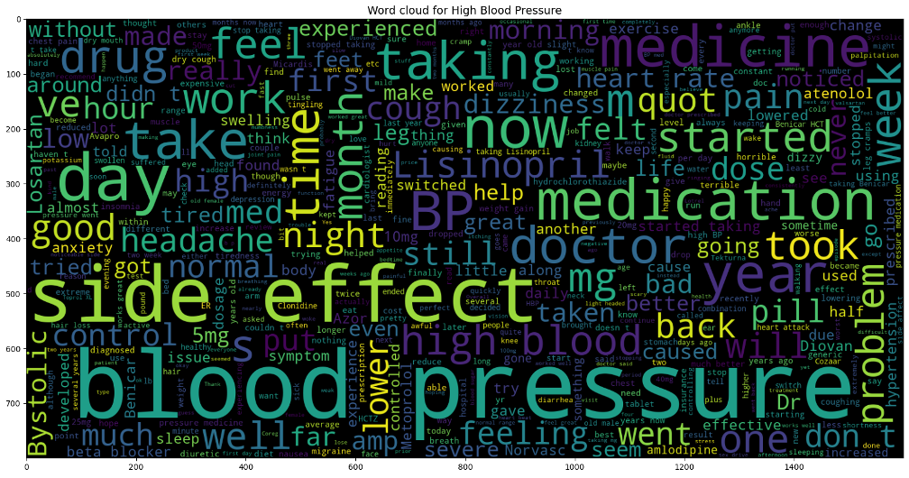
Activities Performed
Part-1
Collected and analyzed UCI Drug Review Dataset (215K+ records, 8 attributes).
Cleaned and formatted text data - handled missing values, normalized text, removed punctuation/stopwords.
Implemented text preprocessing pipeline using Python (NLTK, pandas, NumPy).
Visualized frequent medical terms using WordCloud for linguistic analysis.
WordCloud for Blood Pressure
2
M D SRI RAAGHAV (103122060) / B.Tech. / Civil Engg. / NIT-T
Notes:
2

Slide 12
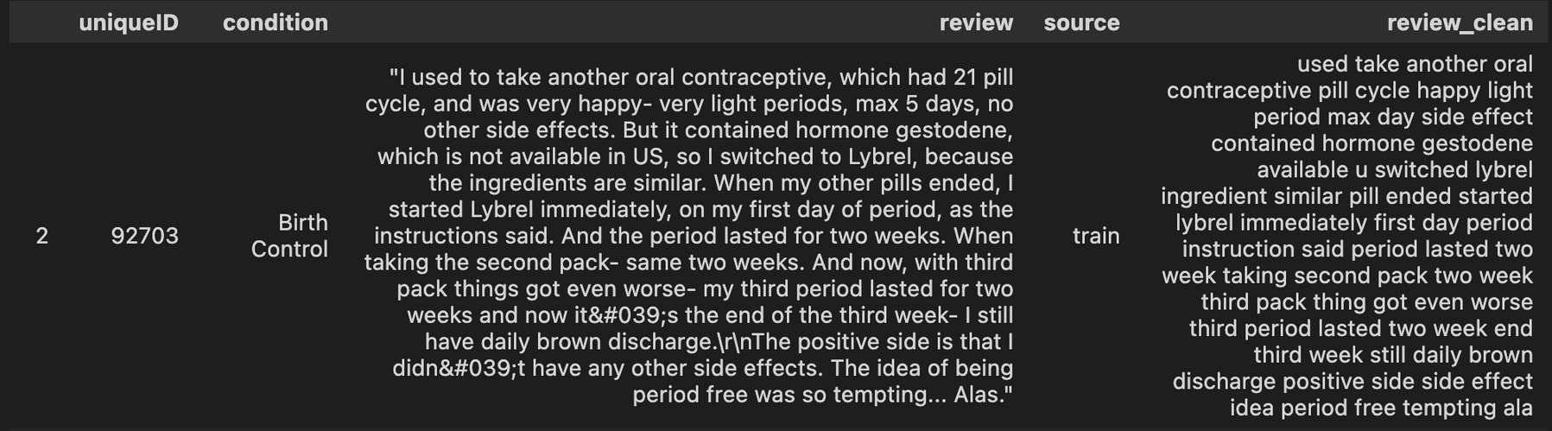
Activities Performed
Part-2
Created a new feature ‘review_clean’ without the stop words and special characters and applying Lemmitization and punctuations.
2
M D SRI RAAGHAV (103122060) / B.Tech. / Civil Engg. / NIT-T
Notes:
2

Slide 13
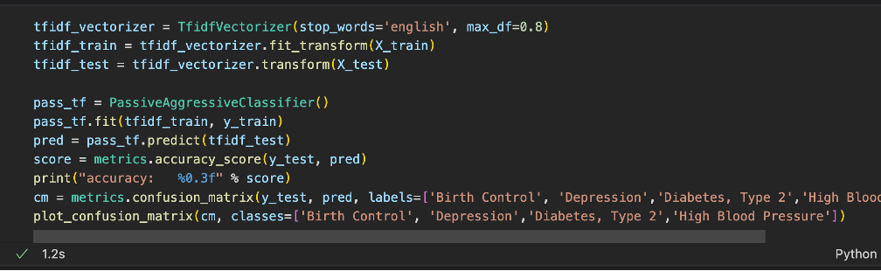
Activities Performed
Part-3
Created TF-IDF pipeline for model input.
Split dataset into 80% training and 20% testing with constant random state.
Trained models:
Multinomial Naïve Bayes
Passive-Aggressive Classifier
Visualized and interpreted confusion matrices for each model.
Evaluated models on accuracy and classification metrics.
TF-IDF Pipeline
2
M D SRI RAAGHAV (103122060) / B.Tech. / Civil Engg. / NIT-T
Notes:
2

Slide 14
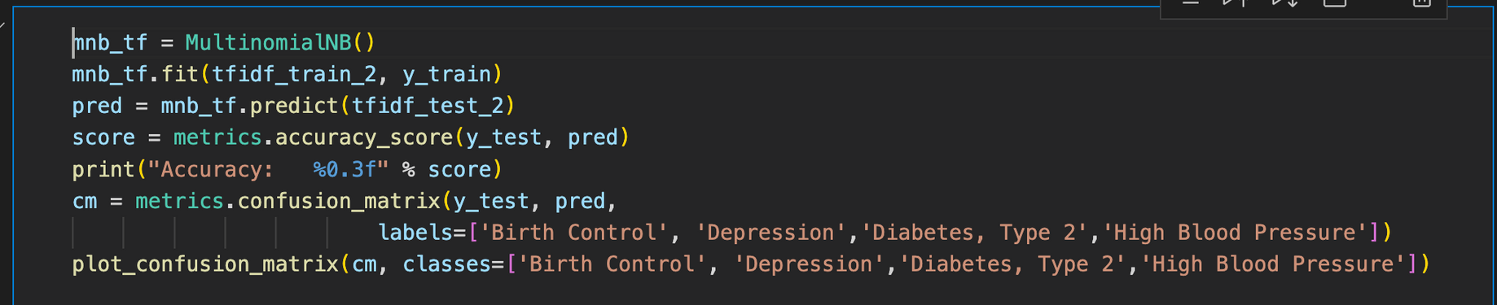
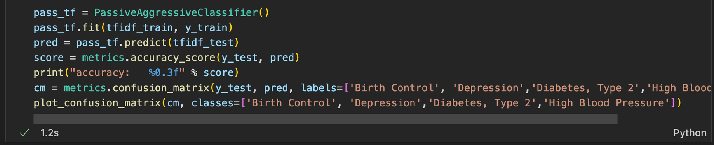
Confusion Matrix Computed
Multinomial Naive Bayes
Passive Aggressive Classifier
2
M D SRI RAAGHAV (103122060) / B.Tech. / Civil Engg. / NIT-T
Notes:
2

Slide 15
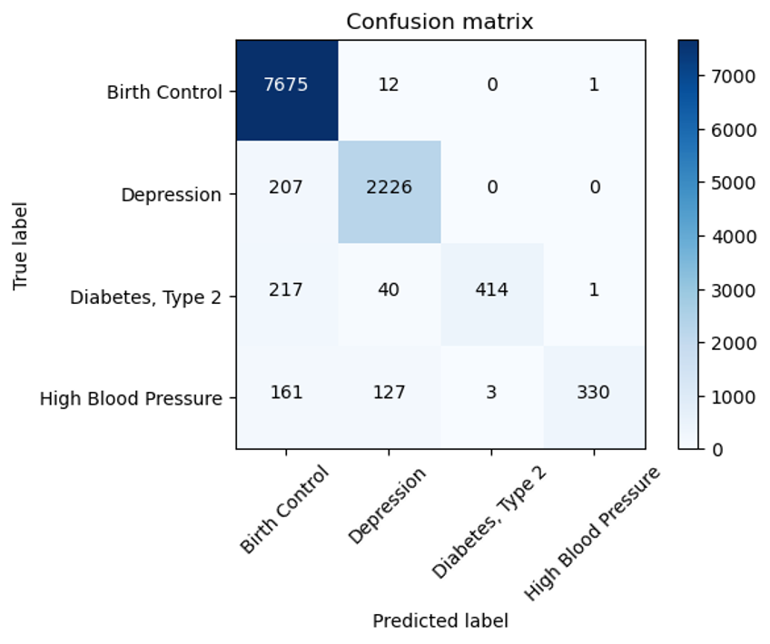
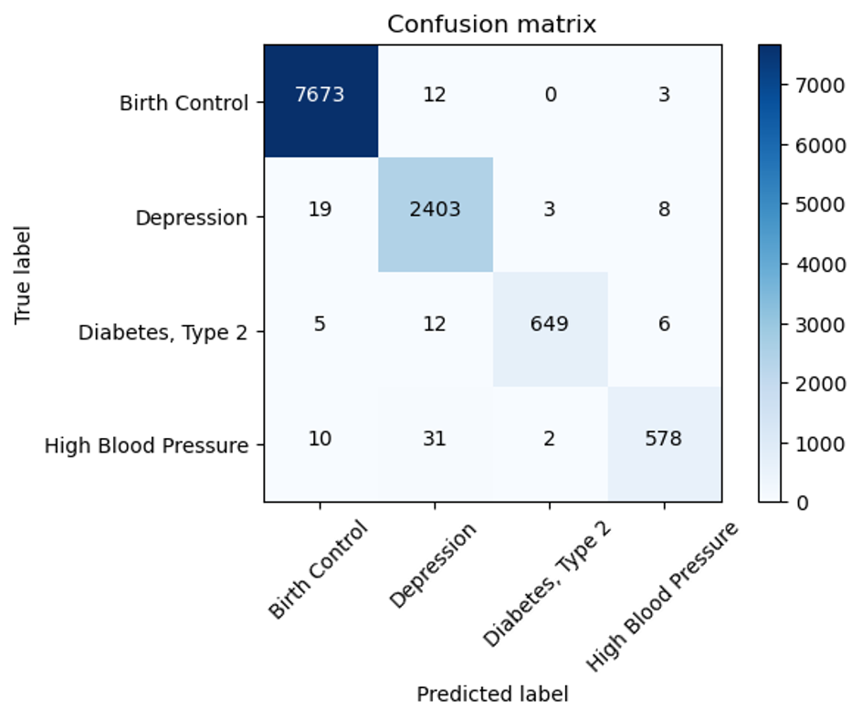
Confusion Matrix Computed
Multinomial Naive Bayes
Passive Aggressive Classifier
2
M D SRI RAAGHAV (103122060) / B.Tech. / Civil Engg. / NIT-T
Notes:
2

Slide 16
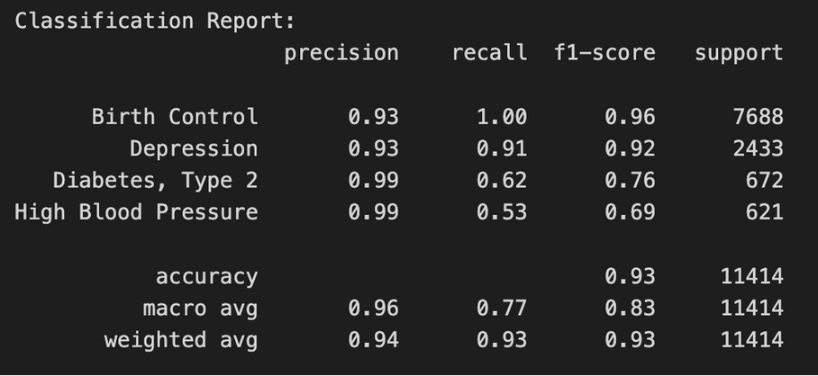
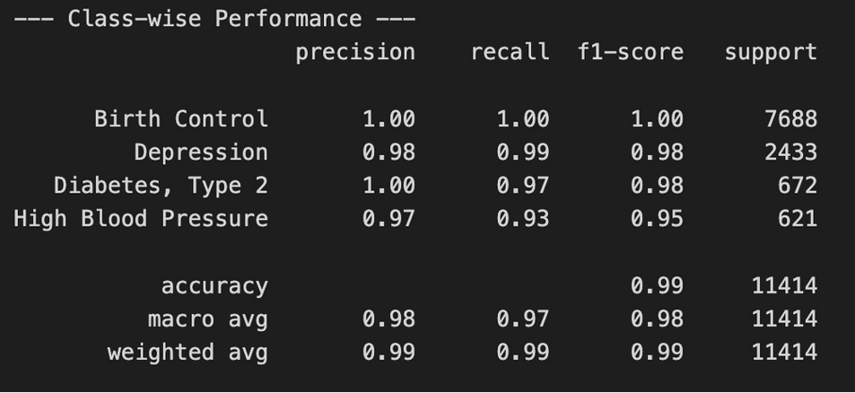
Activities Performed
Part-4
Compared model performances:
PAC Accuracy: 99.0%
MNB Accuracy: 93.3%
Analyzed class-wise performance (e.g., Birth Control, Depression, Diabetes).
Identified linguistic patterns influencing predictions.
Documented limitations, including lack of multi-condition data and semantic ambiguity.
Proposed future scope: BERT embeddings.
2
M D SRI RAAGHAV (103122060) / B.Tech. / Civil Engg. / NIT-T
Notes:
2

Slide 17
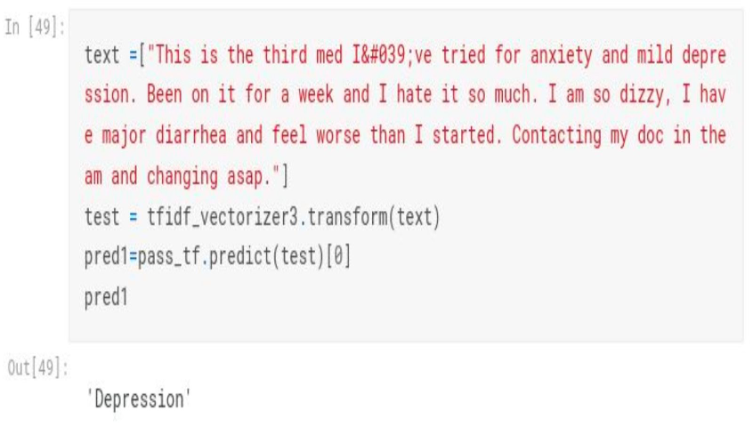
Activities Performed
Part-5
Finally Tested our NLP classification mode with test data of real world drug review and the model has diagnosed it perfectly.
2
M D SRI RAAGHAV (103122060) / B.Tech. / Civil Engg. / NIT-T
Notes:
2

Slide 18




Key Knowledge / Skills Gained
Technical Skills:
Gained proficiency in Python programming, particularly with key libraries such as pandas for data manipulation, scikit-learn (sklearn) for model building, and matplotlib & seaborn for effective data visualization and interpretation.
Developed expertise in Natural Language Processing (NLP), including text cleaning, tokenization, stop-word removal, lemmatization, and feature extraction techniques like TF-IDF Vectorization.
Strengthened understanding of model evaluation techniques — calculating precision, recall, F1-score, and creating confusion matrices to interpret classification performance
Tech Stack (Libraries)
2
M D SRI RAAGHAV (103122060) / B.Tech. / Civil Engg. / NIT-T
Notes:
2

Slide 19
Key Knowledge / Skills Gained
Analytical Skills:
Improved ability to understand text semantics, enabling better context-driven model performance in text classification.
Strengthened my EDA-Visualisation & Pre-processing techniques
Domain Insight:
Gained in-depth knowledge of applying AI and NLP techniques—including text vectorization, feature extraction, and supervised learning models—to healthcare data analytics.
Explored methodologies for disease entity recognition, and automated tagging to enhance clinical data organization and retrieval.
2
M D SRI RAAGHAV (103122060) / B.Tech. / Civil Engg. / NIT-T
Notes:
2

Slide 20
Internship Benefits
Benefits to Me:
Gained hands-on experience in NLP and machine learning.
Improved EDA, Value Imputation, and data analysis abilities.
Developed confidence in applying AI concepts to real-world domains like healthcare.
Benefits to the Organization:
Provided research insights into linguistic and semantic patterns across medical conditions, enriching the department’s data resources.
Future Application for Dr. Vinay Raj: The developed system can be extended to real-time clinical text processing, enabling Dr. Vinay Raj’s research team to explore areas like adverse drug reaction detection, symptom clustering, and medical text summarization using the same NLP pipeline architecture.
2
M D SRI RAAGHAV (103122060) / B.Tech. / Civil Engg. / NIT-T
Notes:
2

Slide 21
Conclusions & Recommendations
Conclusions:
NLP and ML can effectively classify medical conditions from unstructured patient reviews.
The Passive-Aggressive Classifier achieved the best accuracy (99.0%), proving robust and efficient.
The project demonstrated how automated classification can reduce manual workload and enhance healthcare analytics.
Recommendations:
Explore transformer-based models (BERT, RoBERTa) for deeper semantic understanding.
Develop a classification tool for hospitals or pharma platforms using AWS Lambda and Flask.
2
M D SRI RAAGHAV (103122060) / B.Tech. / Civil Engg. / NIT-T
Notes:
2

Slide 22
THANK YOU
11
M D SRI RAAGHAV (103122060) / B.Tech. / Civil Engg. / NIT-T
Notes:
11

